Slide 1
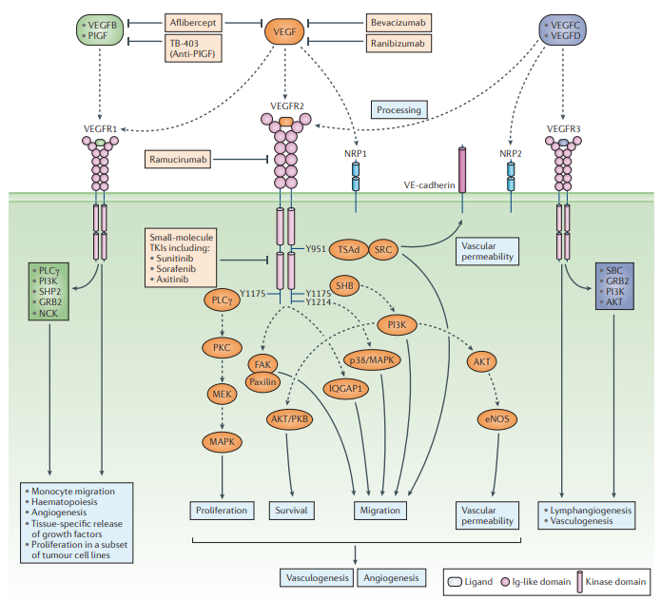
VASCULAR ENDOTHELIAL GROWTH FACTOR AND ITS RECEPTORS

Slide 2
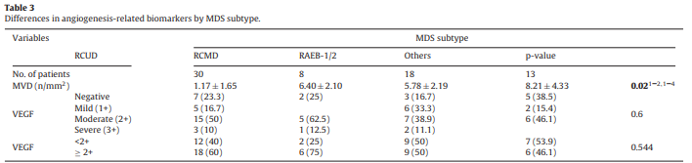
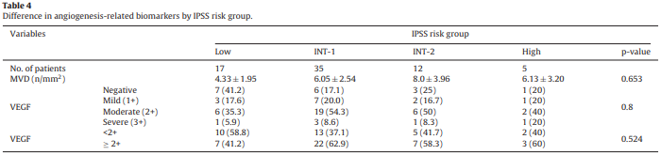
Biomarkers of angiogenesis as prognostic factors in myelodysplastic syndrome patients treated with hypomethylating agents
Differences in angiogenesis-related biomarkers by MDS subtype
MVD of RCUD was significantly lower than in others such as RCMD and RAEB-1/2.
There was no significant differences in VEGF expression according to the subtype of MDS.
Difference in angiogenesis-related biomarkers by IPSS risk group
MVD expression did not differ among the risk groups based on the IPSS.
The low risk group tended to have lower expression of MVD and VEGF.

Slide 3
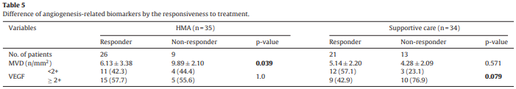
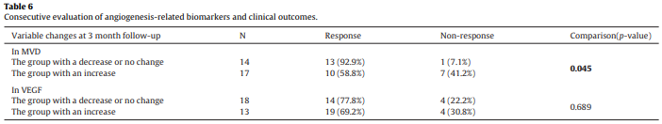
Biomarkers of angiogenesis as prognostic factors in myelodysplastic syndrome patients treated with hypomethylating agents
Differences in angiogenesis-related biomarkers by the responsiveness to treatment
In the HMA group, the mean MVD in the responder group was significantly lower than that of the non-responder group (P = 0.039).
In the supportive care group, the mean MVD for responders was similar to that of 13 non-responders. The strong VEGF expression in non-responders tended to be more frequent than in responders (P = 0.079).
Consecutive evaluation of angiogenesis-related biomarkers and clinical outcomes
The group with a decrease or no change of MVD had a higher response rate compared to that in the group with an increase of MVD (P = 0.045).

Slide 4
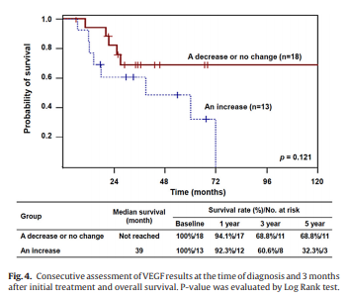
Biomarkers of angiogenesis as prognostic factors in myelodysplastic syndrome patients treated with hypomethylating agents
Although the changes of angiogenesis-related biomarkers were not associated survival outcomes, the group with a decrease or no change of VEGF had a trend to have a better survival outcome.
Consecutive assessment of VEGF results at the time of diagnosis and 3 months after initial treatment and overall survival
Leuk Res. 2016 Nov;50:21-28.

Slide 5
Area of controversies
References | No. | Method | Findings
Leuk Res. 2006 Mar;30(3):247-53. | 53 | MVD | MDS > Healthy control (P = 0.02) Highest in RAEB group (P = NS) BM blast (P = NS) MVD !∝ OS
Am J Clin Pathol. 2013 Mar;139(3):380-7. | 79 | VEGF levels (VEGFi) = Cellularity × VEGF⁺ CD34+ cells by IHC / 10⁴ | VEGFi – Very high risk (WPSS) > Very low risk (WPSS) (P = 0.01), Poor or Intermediate karyotype > Good karyotype (P = 0.015) High VEGFi ∝ T/F dependency (OR 10.38; 95% CI 1.02– 106.0), Poor LFS and OS
Leukemia. 2008;22:530-537. | 128 | Circulating endothelial cells (CEC) by flow cytometry | CEC – MDS > Control (P < 0.01) CEC ∝ -IPSS (R = -0.55, P <0.01) CEC ∝ MVD (R = 0.62, P <0.01) Progenitor-to-mature CEC ratio = MDS > Control (P <0.01) CEC ∝ ECFC (Endothelial colony-forming cells) (R= 0.57, P = 0.02) ECFC – MDS > Control (P = 0.01)
Pathol Oncol Res. 2012 Jul;18(3):681-90. | 71(50) 31(20) | MVD VEGF expression (IHC) | MVD – MDS > Control (P = 0.03) VEGF expression – MDS ≒ Control MVD ∝ survival (P = 0.02), ~∝ in multivariate analysis VEGF expression !∝ survival

Slide 6
Area of controversies
References | No. | Method | Findings
Br J Haematol. 2007 May;137(3):206-15. | 9 10 10 8 | MVD qRT-PCR | MVD – MDS & de novo AML > Control, MDS OL < MDS, OL < de novel AML Angiogenic mediator gene expression (VEGF, bFGF, TNFα, HFG, Ang-1, Ang-2) & receptors of angiogenic mediators (VEGFR2, TIE2) – MDS OL < de novo AML Anti-angiogenic mediator gene expression (TGFβ) – MDS OL > de novo AML
Br J Haematol. 2002 Jul;118(1):151-6. | 41 66 | Western blot Radioimmunoassay (BM mononuclear cells) | VEGFR-1 – AML > MDS (P < 0.01) VEGFR-2 – AML ≒ MDS (P = 0.50) VGEFR-1, VEGFR-2 ~∝ survival, VEGF -∝ survival VEGF ∝ VEFGR-2 in AML and MDS (P < 0.01), VEGF !~ VEGFR-1
Leuk Lymphoma. 2017 Jul;58(7):1711-1720. | 188 96 | VEGF (IHC) VEGF (BM plasma level & supernatant) | VEGF – MDS > Control (P < 0.01), VEGF release – low risk > high risk (P < 0.05) VEGF level ∝ Apoptotic rate by nuclear DNA fragmentation assay (P < 0.01) VEGF level ∝ OS, PFS
 | 46 5 | VEGF (IHC) MVD RT-PCR (isolated neoplastic cells - MNC) | Normal BM – myeloid progenitor cells, immature monocytic cells, plasma cells, and megakaryocyte (+) RAEB, RAEB-T, CMML > RA, RARS, Normal (immature myeloid cells) MVD – RAEB-T, CMML > RA, RARS, Normal MDS cells not only produce VEGF, but also several different VEGFR

Slide 7
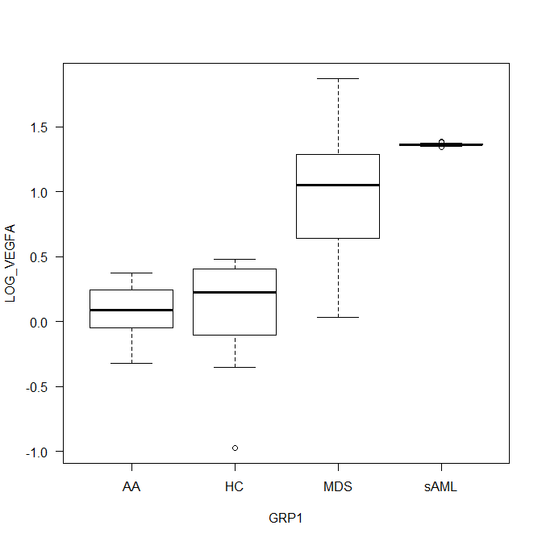
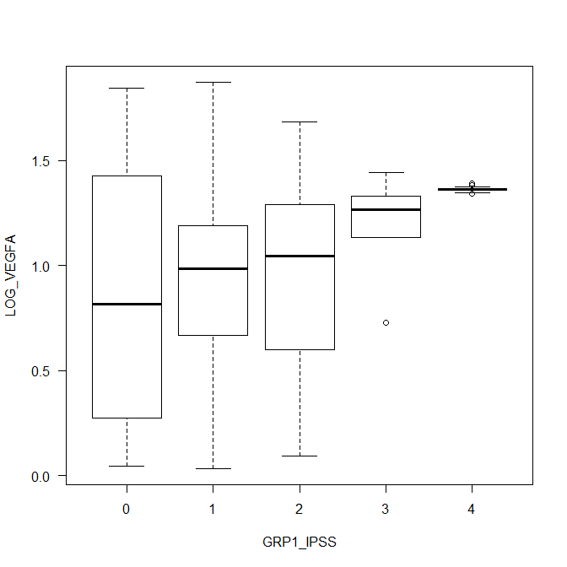
Our results
AA
HC
MDS
sAML
Low
Int-1
Int-2
High
sAML
Group | No. | Median (Lowest-Highest)
AA | 8 | 0.09 (-0.32 – 0.38)
Healthy control | 18 | 0.23 (-0.98 – 0.48)
MDS | 84 | 1.05 (0.03 – 1.88)
sAML | 17 | 1.36 (1.34 – 1.39)
AA vs MDS (P < 0.01), AA vs sAML (P < 0.01), HC vs MDS (P < 0.01), HC vs sAML (P < 0.01), MDS vs SAML (P < 0.01)
IPSS | No. | Median (Lowest-Highest)
Low | 6 | 0.82 (0.04-1.84)
Int-1 | 43 | 0.99 (0.03-1.88)
Int-2 | 29 | 1.04 (0.09-1.69),
High | 6 | 1.27 (0.73-1.44)
sAML | 17 | 1.36 (1.34-1.39)
Low vs Int-2 (P = 0.04), Low vs sAML (P < 0.01), Int-2 vs sAML (P < 0.01), High vs sAML (P < 0.01)

Slide 8
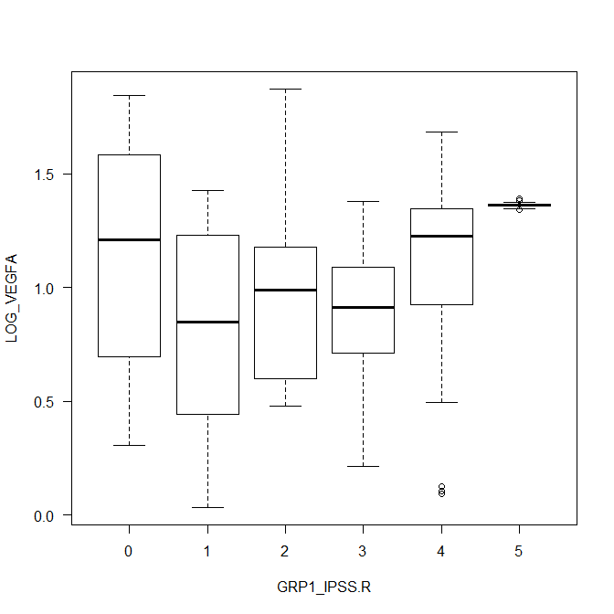
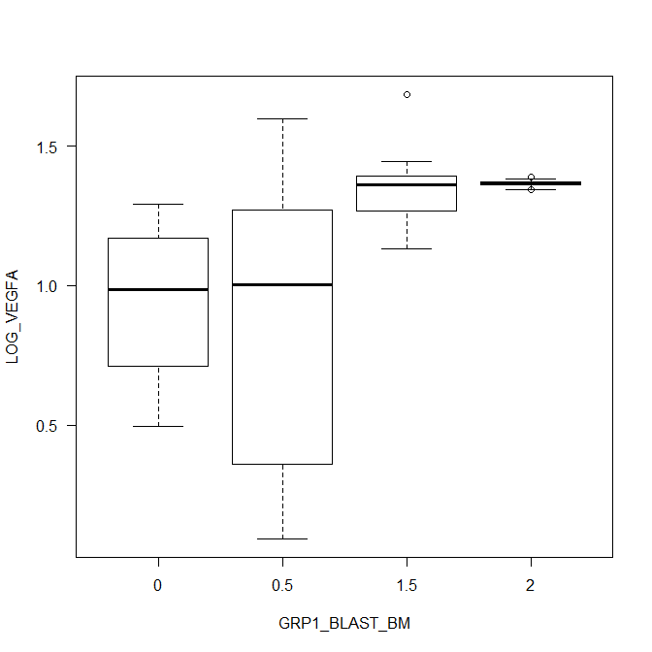
Our results
VLow
Low
Int
High
VHigh
sAML
<5
5-10
11-20
>20
IPSS-R | No. | Median (Lowest-Highest)
Very low | 4 | 1.21 (0.30-1.84)
Low | 16 | 0.85 (0.03-1.43)
Int | 20 | 0.99 (0.48-1.88)
High | 20 | 0.91 (0.21-1.38)
Very high | 24 | 1.23 (0.09-1.69)
sAML | 17 | 1.36 (1.34-1.39)
Very low vs sAML (P < 0.01), Low vs sAML (P < 0.01), High vs sAML (P < 0.01), Very high vs sAML (P < 0.01)
Blast by IPSS | No. | Median (Lowest-Highest)
<5 | 46 | 0.93 (0.03-1.84)
5-10 | 27 | 1.02 (0.09-1.88)
11-20 | 13 | 1.33 (0.73-1.69)
>20 | 15 | 1.36 (1.37-1.39)
<5 vs 11-20 (P < 0.01), <5 vs >20 (P < 0.01), 5-10 vs 11~20 (P = 0.01), 5~10 vs >20 (P < 0.01)

Slide 9
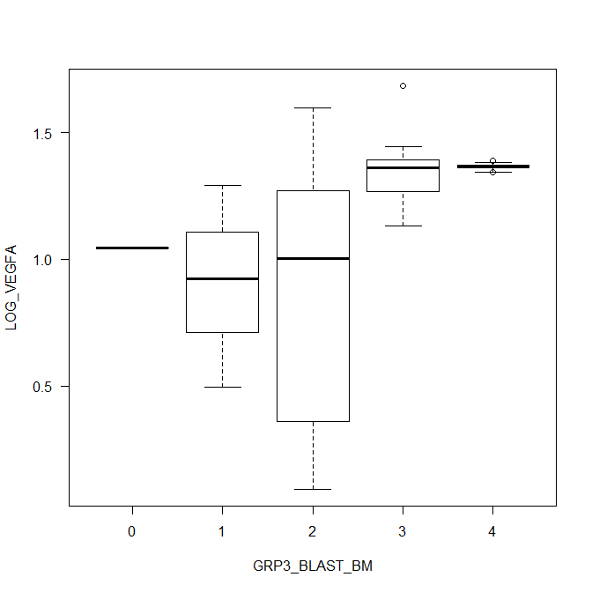
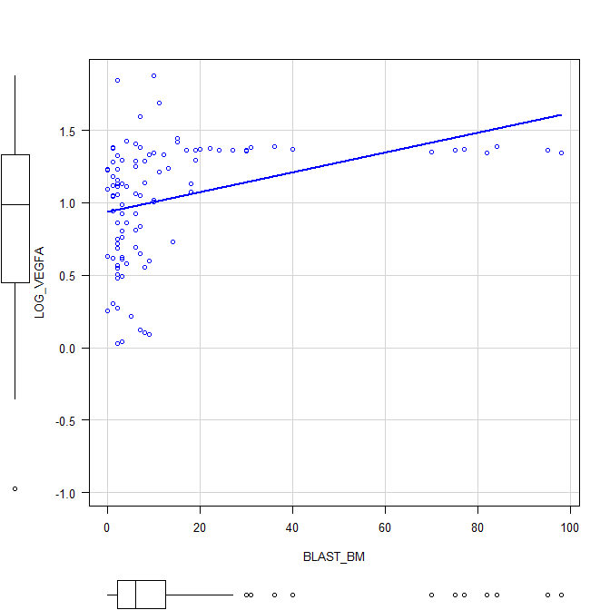
Our results
R² = 0.114
≤2
2-5
5-10
10-20
>20
IPSS-R | No. | Median (Lowest-Highest)
≤2 | 32 | 1.05 (0.03-1.84)
2.1-4.9 | 14 | 0.84 (0.04-1.43)
5-10 | 27 | 1.02 (0.09-1.88)
10.1-20 | 13 | 1.33 (0.73-1.69)
>20 | 15 | 1.36 (1.34)-1.39
≤2 vs 10.1~20 (P < 0.01), ≤2 vs >20 (P <0.01), 2.1~4.9 vs 10.1~20 (P < 0.01), 2.1~4.9 vs >20 (P < 0.01), 5~10 vs 10.1~20 (P = 0.01), 5~10 vs > 20 (P < 0.01)

Slide 10
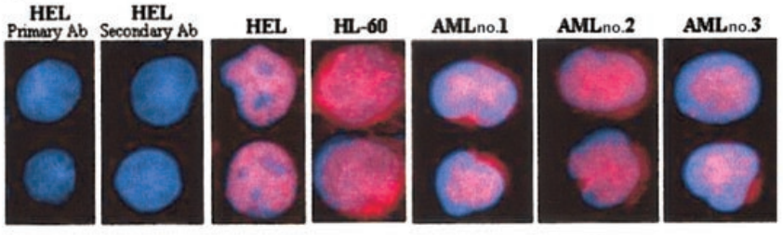
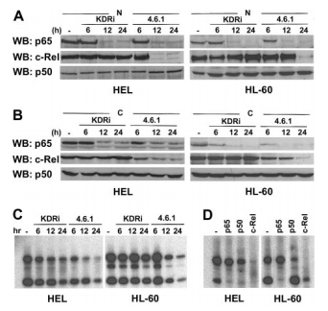
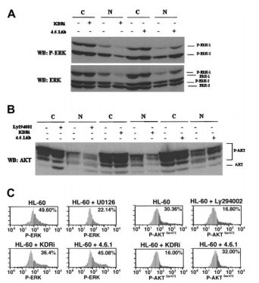
Internal and external autocrine VEGF/VEGFR2 loops
Phosphorylated VEGFR2 in the nuclear protein fractions of untreated cells, suggesting the autocrine loop might result in VEGR2 activation
Anti-VEGF Ab. Blocks NF-κB
VEGFR2-specific intracellular inhibitor (4.6.1) blocks MAP3 and PI3K pathway

Slide 11
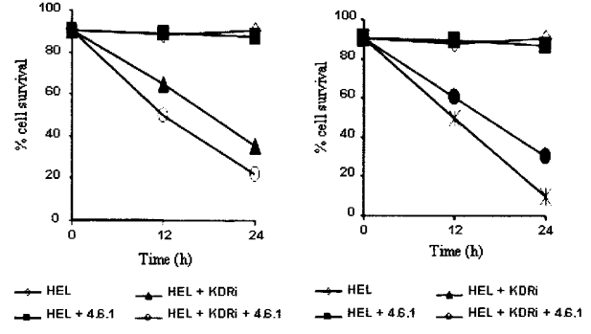
Internal and external autocrine VEGF/VEGFR2 loops
Anti-VEGF Ab. – a little effect on cell survival
VEGFR2-specific intracellular inhibitor – induced leukemia apoptosis
Anti-VEGF Ab. + VEGFR2-specific intracellular inhibitor – reduce cell survival to larger extent than either agent alone
Blood. 2004 May 15;103(10):3883-9.

Slide 12
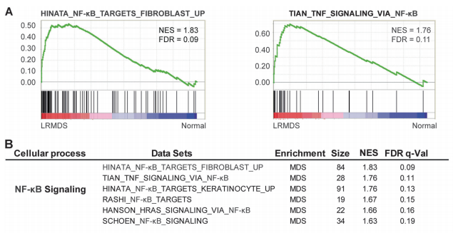
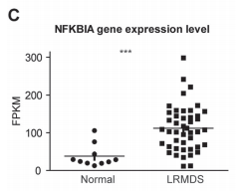
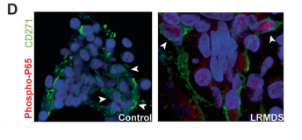
Activation of NF-κB driven inflammatory programs in mesenchymal elements attenuates hematopoiesis in low-risk MDS
NFKBIA - NF-κB inhibitor forms an auto-regulatory loop
Gene set enrichment assay (GSEA) shows that a remarkable abundance of signatures related to the activation of the nuclear factor-kappa B (NF-κB) family of transcription factors
Increased phosphorylation of p65, a component of the activated NF-κB complex, in intramedullary located CD271+ mesenchymal cells
Leukemia. 2019 Feb;33(2):536-541.

Slide 13
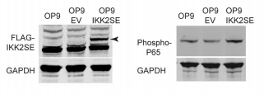
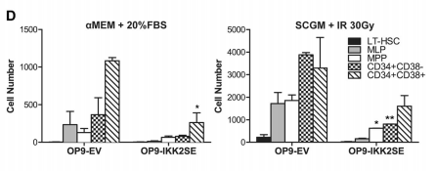
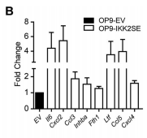
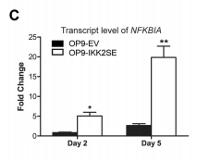
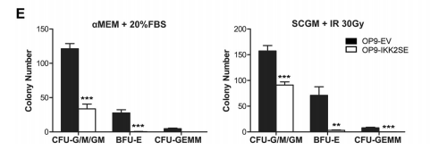
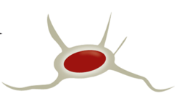

Activation of NF-κB driven inflammatory programs in mesenchymal elements attenuates hematopoiesis in low-risk MDS
OP9 cells, like CD271+ cells, express osteolineage commitment markers as well as HSPC regulatory factors and robustly support the expansion of human HSPCs
Transfection via lentivirus
FLAG-IKK2SE – a constitutively active form of IKK2, a kinase upstream regulator of NF-κB
negative regulators of hematopoiesis
NF-kB ↑
HSPC ↓
PLoS One. 2016 Feb 2;11(2):e0146722.
Leukemia. 2019 Feb;33(2):536-541.

Slide 14
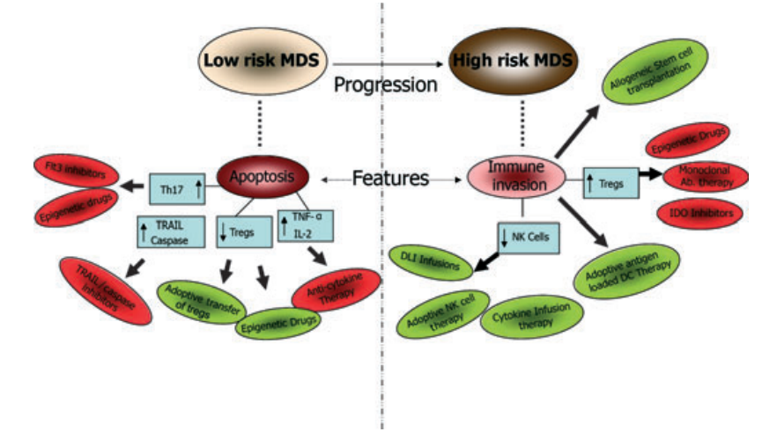
Low vs high-risk myelodysplastic syndrome
Inflammatory response O
Inflammatory response X

Slide 15
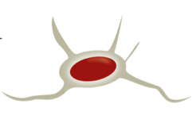
Area of uncertainty
Paracrine
VEGF
External autocrine
?
NF-κB ↑
VEGF
Inflammatory cytokine
VEGFR2
Internal autocrine
NF-κB ↑
Negative regulators
VEGF
Mesenchymal cell
MDS Blast
Number ↓
Function ↓
HPSC

